Slide 1
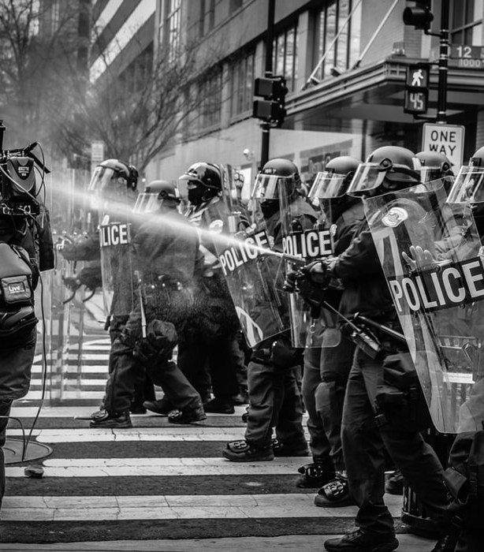
A young man’s thoughts before June 16
BY FHAZEL JOHENNESSE
COMPILED BY CAITLINJESSICA

Slide 2
tomorrow i travel on a road
that winds to the top of the hill
i take with me only the sweet
memories of my youth
my heart aches for my mother
for friday nights with friends
around a table with the broad belch of beer

Slide 3
i ask only for a sad song
sung by a woman with downturned eyes
and strummed by an old man with
a broken brow
o sing my sad song sing for me
for my sunset is drenched with red

Slide 4
The Title
On 16 June 1976, high school children from Soweto marched to protest against the government law that their schooling had to be in Afrikaans.
The police shot bullets and tear gas, and many were injured or killed.
In this poem, Johennesse imagines himself as one of those teenagers the day before the event, foreseeing the tragedy that will take place.

Slide 5
Structure
The poem consists of 13 lines.
Rhyme Scheme: Free verse (no rhyming pattern).
Enjambment – sentences are not punctuated (implies confusion and uncertainty about the future). The speaker does not know what will happen.

Slide 6
Word choice (diction)
The tone is sad or mournful and is created by the diction.
The diction has a negative connotation:
Aches
A Sad Song
Downturned Eyes
A Broken Brow
Drenched With Red (Implying Blood)

Slide 7
Imagery
Imagery of mourning is created in lines 8 - 13
Figurative Language
Travelling on a road: road is a Metaphor for a choice
Symbolism: Drenched in red = drenched in blood.

Slide 8
Theme
The horror that awaited young protesters on June 16th. It is told from the perspective of the young man who could possibly die in the violence that ensued on that day.
It is also a comment on cruelty of the apartheid regime.

Slide 9
Line 1
•“Tomorrow” – refers to the day of the protest.
•“i” –alone, one person on journey. Suggests
acknowledgement of insignificance in comparison to
situation.
•Written in present tense - sense of immediacy.
Line 2
•“winds” – symbolise challenges/ difficulties faced.
•“top of the hill” – symbolises end goal – to be taught
in language of choice.
•Metaphor lines 1 - 2 : Life compared to a road - is a
journey.
tomorrow i travel on a road
that winds to the top of the hill
i take with me only the sweet
memories of my youth
my heart aches for my mother
for friday nights with friends
around a table with the broad belch of beer
i ask only for a sad song
sung by a woman with downturned eyes
and strummed by an old man with
a broken brow
o sing my sad song sing for me
for my sunset is drenched with red
a twising route
Lines 4 – 5
•Emphasis on the human aspects of protest rather than political.
•The speaker worries about his mother and news of his death.
a dull pain
Lines 3 – 4
•Only thing he can take with on his journey - the
memories he made.
•He is leaving his youth behind.
Burp noisily
Lines 6 – 7
Simpler times in life (social aspect).
Line 8
•Wants “only a sad song” – only thing he wants from parents/adults during time of mourning for youth.
Line 9
•“downturned eyes” – suggests grieving and weeping
Lines 10 – 11
•“strummed” – Action of playing a stringed instrument
•“a broken brow” –(lines/creases on the forehead).
from grief / years of oppression.
Sweeping fingers across strings
Lines 12 – 13
Not gentle death – drenched in red (blood).
Sunset symbolic for end.
Lives of many young people ended by police during protest that took place on June 16th.
Person’s forehead
Soaked through

Slide 10
Questions
1. | Identify three things that the poet knows he will have to give up once he embarks on his journey of protest. |  | (3)
2. | Match the lines in the table below with their literary characteristics: |  | (5)
 | Line(s) | Literary characteristic
 | Line 7 | Enjambment
 | Lines 3-4 | Euphemism
 | Line 13 | Alliteration | (3)
3. | Discuss the context in which this poem was written. |  | (3)
4. | What is the meaning of the last two lines of the poem? |  | (5)
5. | Choose the answer that you think best sums up the main message of this poem from the options below:
 | The poem concentrates on the human aspects of this young freedom fighter, rather than his political intentions. The poem expresses the anger that people felt about the inferiority of their education. The poem expresses a longing for home and family life. |  | (1)

